Slide 1
Language technology for low-resource languages
Day 3/5
LOT 2018, Groningen
Yves Scherrer, University of Helsinki

Slide 2
What resources can we get?
Is there manually annotated training data?
yes
no
Use supervised NLP techniques
Is there relevant training data from other languages?
yes
no
Use cross-lingual learning methods
Are there monolingual corpora?
Main topic of this course
yes
no
Use unsupervised NLP techniques
Annotate data
Collect and annotate data
Adapted from Y. Tsvetkov

Slide 3
Data transfer approaches
Annotation projection:
Build task model for language A
Apply word alignment tool
Build task model for language B
Training data translation:
Build MT model for A – B
Build task model for language B
Test data backtranslation:
Build task model for language A
Build MT model for B – A
2 models = 2 opportunities to produce errors...
Can we get by with a single model?

Slide 4
Cross-lingual learning techniques
We have the data to train a model for language A, but need a model for language B
Data transfer:
Convert the training data to language B
Train a model on the converted data of language B
Annotation projection, data translation
Model transfer:
Train a model for language A
Convert the model so that it applies to language B
Plain model transfer, delexicalization, relexicalization
Multilingual/multitask models
Today

Slide 5
Model transfer

Slide 6
Overview
Plain model transfer:
Pretend that languages A and B are in fact the same
Train a model on A, apply it to B without change
Delexicalisation:
Train a model on A, remove all language-specific features (e.g. word forms) and replace them by language-independent features
Relexicalisation:
Train a model on A, replace all A-specific features by B-specific features

Slide 7
Overview
Parallel corpora are not strictly required for model transfer methods, but...
... they may be useful for finding language-independent features
... they may be useful for matching A-specific with B-specific features

Slide 8
Plain model transfer Tagging
Don’t even try it for unrelated languages...
High-resource language (A) | “Low-resource” language (B) | Accuracy | Tagset size
Spanish | Catalan Aragonese | 58% 72% | 42
German | Dutch | 24% | 55
Czech | Slovak Polish | 81% 66% | 57
Slovak (+Translit.) Polish (+Translit.) Ukrainian | Rusyn | 43% 50% 63% | 657 920 1040
Scherrer, Y. (2014): Unsupervised adaptation of supervised part-of-speech taggers for closely related languages. Proceedings of the VarDial Workshop 2014.
Scherrer, Y. & Rabus, A. (2017): Multi-source morphosyntactic tagging for Spoken Rusyn. Proceedings of the VarDial Workshop 2017.

Slide 9
Plain model transfer Dependency parsing
VarDial 2017 shared task on cross-lingual dependency parsing – Baselines:
High-resource language | “Low-resource” language | LAS | UAS
Slovenian | Croatian | 53.35 | 63.94
(supervised) | Croatian | 68.51 | 75.61
Danish | Norwegian | 54.91 | 64.53
Swedish | Norwegian | 56.63 | 66.24
(supervised) | Norwegian | 78.23 | 82.28
Czech | Slovak | 53.72 | 65.70
(supervised) | Slovak | 69.14 | 76.57
M. Zampieri et al. (2017): Findings of the VarDial Evaluation Campaign 2017. Proceedings of the VarDial Workshop 2017.

Slide 10
Plain model transfer
Plain model transfer (kind of) works because some words happen to be the same in both languages (and because word order largely is the same)
Numbers, punctuation signs, proper nouns
Loanwords, cognates
For unrelated languages, there are few such cues
Idea: use language-independent cues
For a parser, part-of-speech tags (in a common format) are language-independent cues

Slide 11
Reading
Ryan McDonald, Slav Petrov & Keith Hall (2011): Multi-source transfer of delexicalized dependency parsers. Proceedings of EMNLP. https://www.aclweb.org/anthology/D11-1006
Questions:
What is delexicalization?
The authors propose to use delexicalization for parsing. Would this approach also work for other tasks, such as part-of-speech tagging?

Slide 12
Delexicalization – Parsing
Original paper:
D. Zeman & P. Resnik (2008): Cross-language parser adaptation between related languages. Proceedings of the IJCNLP-08 Workshop for Less Privileged Languages.
Slides: Slav Petrov

Slide 13
Delexicalized Parsing
Original paper:
D. Zeman & P. Resnik (2008): Cross-language parser adaptation between related languages. Proceedings of the IJCNLP-08 Workshop for Less Privileged Languages.
Slides: Slav Petrov

Slide 14
Delexicalized Parsing
Original paper:
D. Zeman & P. Resnik (2008): Cross-language parser adaptation between related languages. Proceedings of the IJCNLP-08 Workshop for Less Privileged Languages.
Slides: Slav Petrov

Slide 15
Delexicalized Parsing

Slide 16
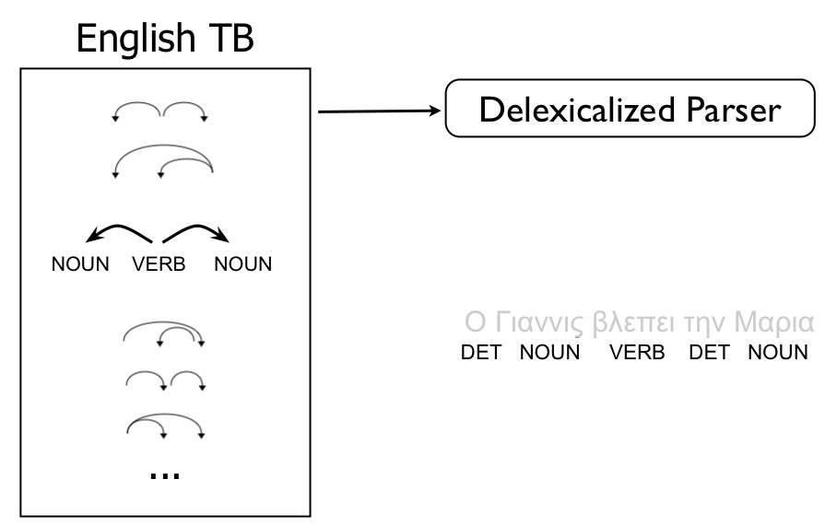
Delexicalized Parsing

Slide 17
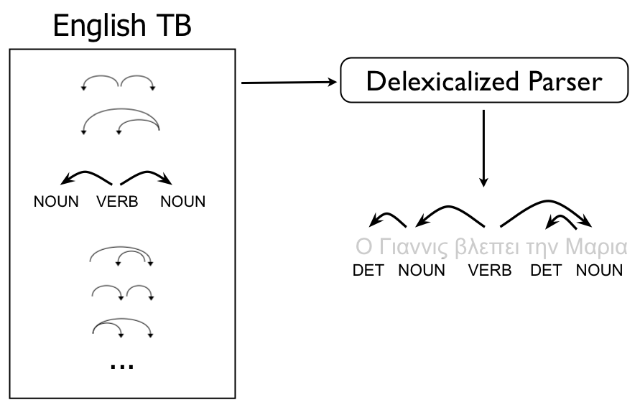
Delexicalized Parsing

Slide 18
Delexicalized Parsing
Does this work?
Lexicalized parser for English (standard): 89% UAS
Delexicalized parser for English: 83% UAS
The POS tag is the most important information for a parser.
Original work is on Danish -> Swedish:
Train a Danish parser and apply it to Swedish without change (plain model transfer): 43.28% F-measure
Train a delexicalized parser on Danish and apply it to Swedish: 65.50% F-measure
Train a lexicalized parser on Swedish (high-resource setting): 77.81% F-measure

Slide 19
Delexicalized Parsing
The languages need to have similar word order
Example: N ADJ N
EN: Adjectives are prenominal, so the parser learns a dependency from the right N to ADJ
FR: Adjectives are (mostly) postnominal, so a parser trained on English will predict a wrong dependency from the right N
Delexicalized parsing assumes that part-of-speech taggers are available for both languages

Slide 20
Delexicalization
Common parsing models look at several features to create the parse tree: word form, lemma, POS tag, …
Delexicalization deprives the parsing model of some features while retaining others.
Language-dependent features (word form, …) are removed
Language-independent features (POS tag, …) are retained
If delexicalization works for parsing, could we do the same for tagging?
What language-dependent features are useful for tagging?
What language-independent features are useful for tagging?

Slide 21
Delexicalized tagging
What language-dependent features are useful for tagging?
Word forms
If we remove them, there is nothing left ☹
What language-independent features are useful for tagging?
Tag sequences (assumed to be identical as in source language)
Word shape (punctuation, numbers, suffixes, word length…)
Word frequency
Previous and following words and how well they predict the current word
Sentence length
Z. Yu, D. Mareček, Z. Žabokrtský, D. Zeman: If you even don’t have a bit of Bible: Learning Delexicalized POS taggers. LREC 2016.

Slide 22
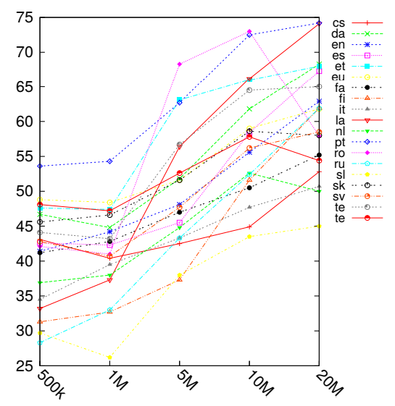
Delexicalized tagging
Different sizes of data used to compute the word statistics
Multi-source model with 7 source languages
Does not work particularly well: 50%-60% for most languages

Slide 24
Delexicalization
Delexicalization in itself rarely works well
Too much useful information is thrown away
Assumptions about language similarity are too strong
But we can improve delexicalization in several ways:
If parallel data are available, we can combine delexicalization with annotation projection
We can replace the word forms by abstract word representations that are comparable across languages
If we have a bilingual dictionary, we can simply translate the word forms: relexicalization

Slide 25
Delexicalization + Annotation projection
R. McDonald, S. Petrov & K. Hall (2011): Multi-source transfer of delexicalized dependency parsers. EMNLP 2011. Slides by Slav Petrov

Slide 26
Delexicalization + Annotation projection
Given: parallel corpus, aligned, parsed on the HRL side
A part of the LRL side is parsed using a delexicalized parser
This parsed corpus is then used to train a new LRL parser
This parser contains lexical information
The rest of the LRL side is annotated with the lexicalized parser.
Several annotations are possible per sentence.
The annotation that best corresponds with the HRL parse (compared through projection) is retained.
A new lexicalized LRL parser is trained on the full, disambiguated LRL side of the corpus.

Slide 27
Delexicalization + Annotation projection
Blue: irrelevant here
Green: delexicalized parser trained on English
Yellow: delexicalized parser trained on English, corrected by annotations projected from English

Slide 28
McDonald et al. 2011
Is it possible to use multiple source languages?
multi-dir: all languages except the target language, direct transfer (delexicalized)

Slide 29
McDonald et al. 2011
Is it possible to use multiple source languages?
multi-proj: all languages except target language, with projection
Generally better than with a single source language

Slide 31
Delexicalization
Delexicalization in itself rarely works well
Too much useful information is thrown away
Assumptions on language similarity are too strong
But we can improve delexicalization in several ways:
If parallel data are available, we can combine delexicalization with annotation projection
We can replace the word forms by abstract word representations that are comparable across languages
If we have a bilingual dictionary, we can simply translate the word forms: relexicalization

Slide 32
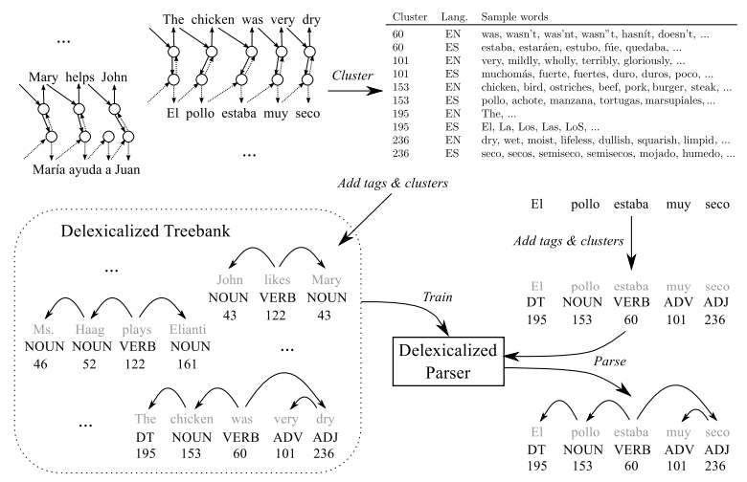
Reading
Oscar Täckström, Ryan McDonald & Jakob Uszkoreit (2012): Cross-lingual word clusters for direct transfer of linguistic structure. Proceedings of NAACL-HLT. http://aclweb.org/anthology/N/N12/N12-1052.pdf
Question:
Try to understand and explain Figure 1.

Slide 33
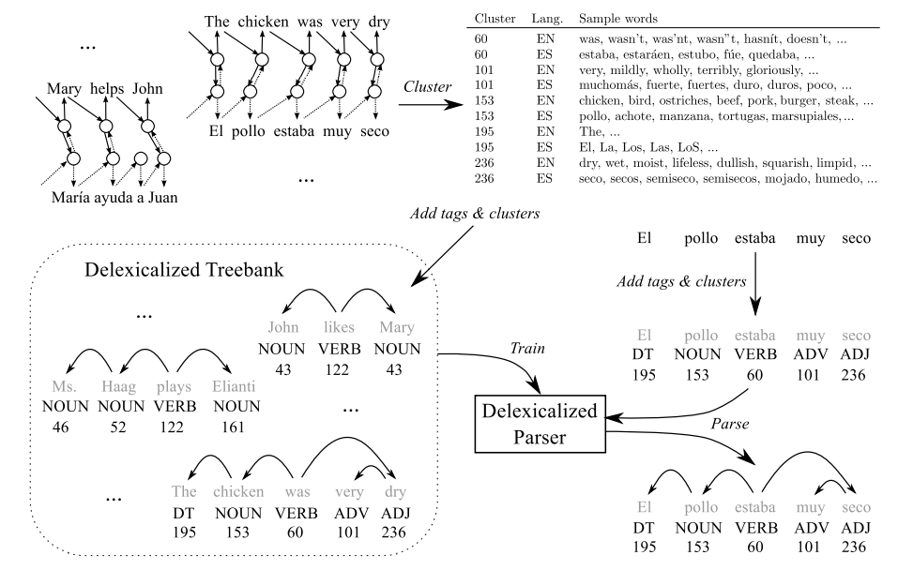

Slide 34
Cross-lingual word clusters
Projected clusters
Create clusters for language A (256) based on prediction from previous word
Assign to each word of language B the cluster of the most often aligned word of language A
Word-aligned parallel corpus required
Cross-lingual clusters
Create clusters for language A (as above)
Project clusters to language B (as above)
Recreate clusters for language B
Project clusters to language A

Slide 35
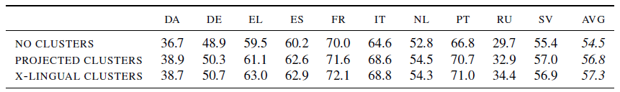
Results
Source language: English
Measure: UAS

Slide 36
Relexicalization using cross-lingual word representations
This model still needs large parallel corpora to synchronize the cluster IDs.
We might as well project the word forms along the alignments.
Can we do something similar without (large) parallel corpora?
Can we use different representations than clusters?
For example... word embeddings?

Slide 37
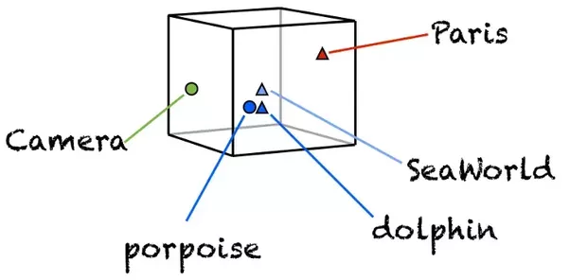
Word embeddings
Represent each word as a multidimensional vector
Each word is defined by its position in a multidimensional space
Words that appear in similar contexts will have similar vectors
A large monolingual corpus is sufficient to infer word embeddings
https://www.quora.com/What-does-the-word-embedding-mean-in-the-context-of-Machine-Learning

Slide 38
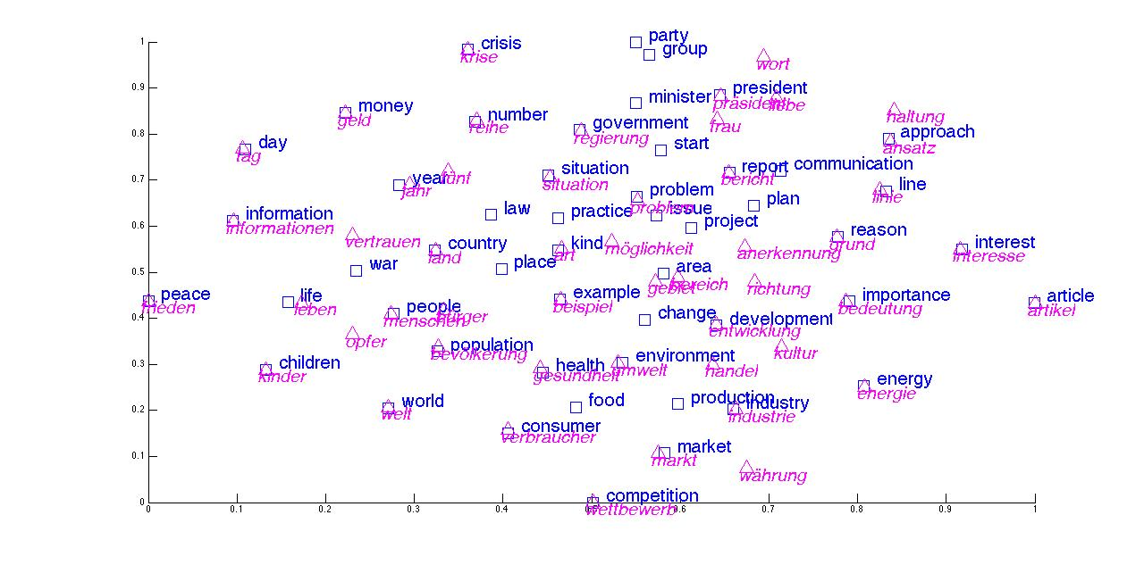
Bilingual word embeddings
Words that are translations of each other should be close to each other in the embedding space
http://www.cs.stanford.edu/~lmthang/bivec/biplot.jpg

Slide 39
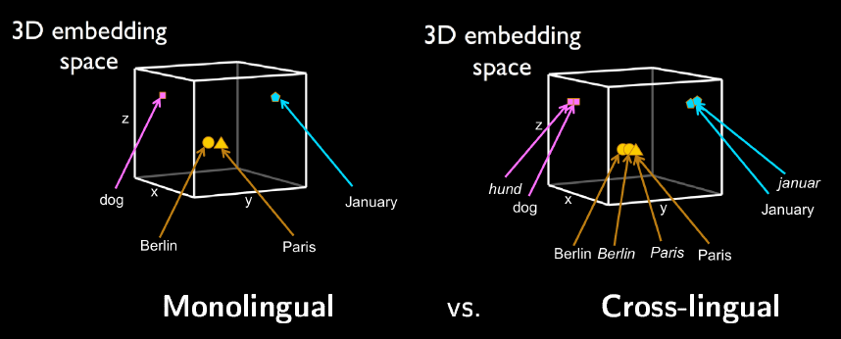
Bilingual word embeddings
How do we make sure that the two vector spaces are comparable?
http://people.ds.cam.ac.uk/iv250/tutorial/xlingrep-tutorial.pdf

Slide 40
Bilingual word embeddings
A huge amount of research
Cf. EMNLP 2017 tutorial on cross-lingual word representations http://people.ds.cam.ac.uk/iv250/tutorial/xlingrep-tutorial.pdf
Two main approaches:
Learn two independent vector spaces, then learn mapping function
Learn single vector space by mixing input data

Slide 41
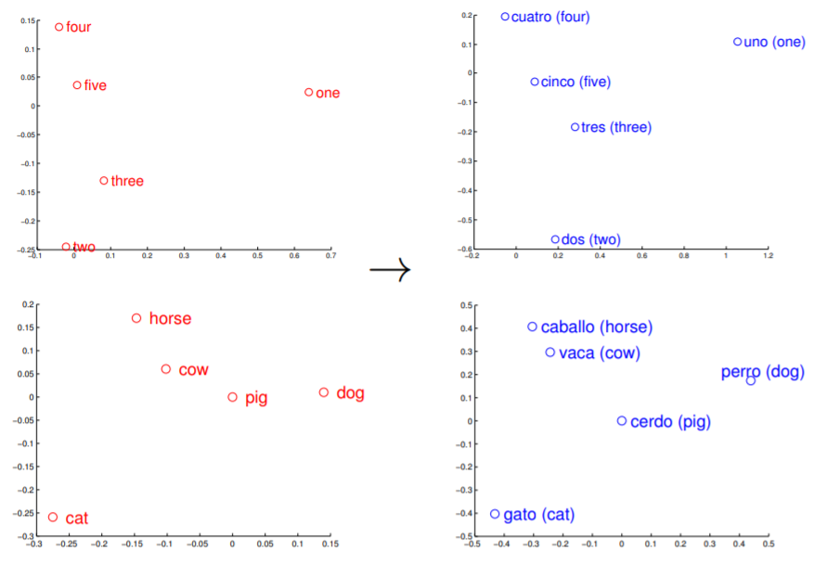
Bilingual word embeddings Mapping approach
The geometric structures of vector spaces look similar across languages:
T. Mikolov et al. (2013): Exploiting similarities among languages for machine translation. ArXiv.

Slide 42
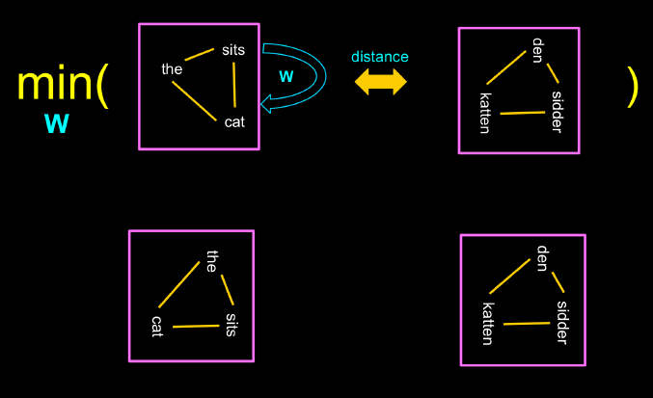
Bilingual word embeddings Mapping approach
Learn to transform the pre-trained source language embeddings into a space where the distance between a word and its translation is minimized -> requires translation pairs
T. Mikolov et al. (2013): Exploiting similarities among languages for machine translation. ArXiv.

Slide 43
Bilingual word embeddings Data mixing approach
Gouws & Søgaard (2015): Simple task-specific bilingual word embeddings. Proceedings of NAACL-HLT.
Bilingual Adaptive Reshuffling with Individual Stochastic Alternatives (BARISTA)
Algorithm:
Replace ½ occurrences of words in A source corpus with B translations
Replace ½ occurrences of words in B source corpus with A translations
Concatenate both corpora, train word embeddings
build the house => build la house
construire la maison
=> construire la house

Slide 44
Bilingual word embeddings Data mixing approach
This presupposes that we can translate words from A to B and from B to A
We can extract word translations from Wiktionary
We don’t need exact translations, only task-specific equivalences
Task-specific equivalences
POS: cat is equivalent to dog (animate nouns)
NER: Trump is equivalent to Putin (president names)
Cross-lingual task-specific equivalences
POS: cat is equivalent to Hund
NER: Trump is equivalent to Poutine

Slide 45
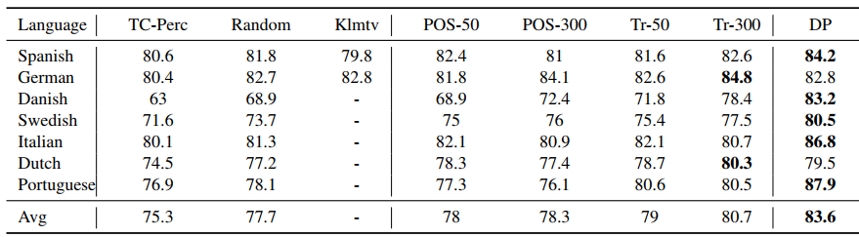
Bilingual word embeddings Data mixing approach
Task: POS-tagging
Delexicalized with embeddings
POS-specific equivalences
50 or 300 dimensions for word embeddings
DP: Das & Petrov, using bilingual corpora
Random embeddings

Slide 46
Bilingual word embeddings Data mixing approach
Task: POS-tagging
Delexicalized with embeddings
True translational equivalences
50 or 300 dimensions for word embeddings
DP: Das & Petrov, using bilingual corpora

Slide 47
Bilingual word embeddings
What can we do if bilingual dictionaries are not available?
M. Artetxe et al. (2017): Learning bilingual word embeddings with (almost) no bilingual data. ACL 2017.
Go back to the mapping approach
A small translation lexicon is sufficient
25 word pairs
Numeral pairs (trivially generated)
Use self-learning to gradually increase the lexicon

Slide 48
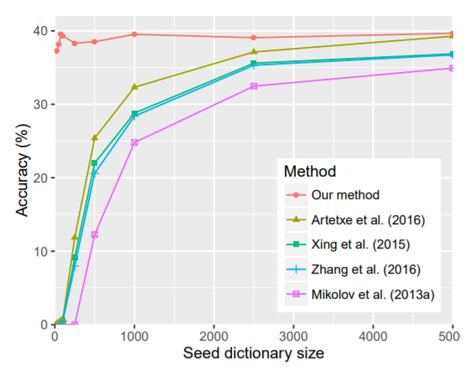
Bilingual word embeddings
Results on bilingual lexicon induction task:
M. Artetxe et al. (2017): Learning bilingual word embeddings with (almost) no bilingual data. ACL 2017.

Slide 49
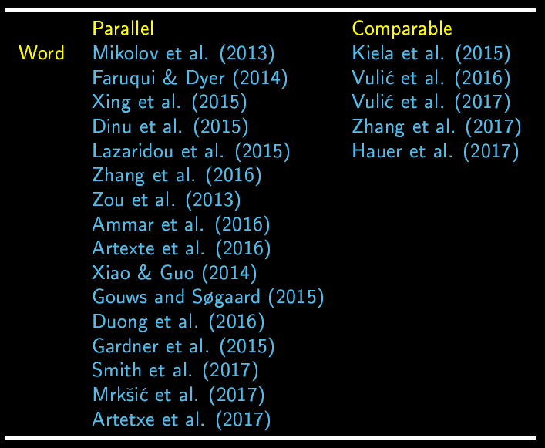
Bilingual word embeddings Other approaches

Slide 51
Delexicalization
Delexicalization in itself rarely works well
Too much useful information is thrown away
Assumptions on language similarity are too strong
But we can improve delexicalization in several ways:
If parallel data are available, we can combine delexicalization with annotation projection
We can replace the word forms by abstract word representations that are comparable across languages
If we have a bilingual dictionary, we can simply translate the word forms within the trained model: relexicalization

Slide 52
Relexicalization
Train a tagger on annotated HRL data
Tag-word associations
Tag sequences
→ Translate words to LRL
→ Keep unchanged
ecologista AQ 5
ecologistas AQ 4 NC 1
ecología NC 3
ecológica AQ 3
ecológicas AQ 1
ecológico AQ 8
ecológicos AQ 2
ecolochía NC 3
ecolochica AQ 3
ecolochicas AQ 1
ecolochico AQ 8
ecolochicos AQ 2
ecolochista AQ 5
ecolochistas AQ 4 NC 1
DT NC 156
DT AQ 23
AQ NC 34
…
DT NC 156
DT AQ 23
AQ NC 34
…

Slide 53
Relexicalization
In order to translate the words in the model parameter file, we need a bilingual dictionary
Extracted from Wikipedia or Wiktionary
Extracted by word alignment from a parallel corpus (Zeman & Resnik 2008)
Generated by matching cognates A. Feldman, J. Hana & C. Brew (2006): A cross-language approach to rapid creation of new morphosyntactically annotated resources. LREC 2006.
This is a whole area of research: Bilingual lexicon induction

Slide 54
Relexicalization using morphological analysis
Train a tagger on annotated HRL data
Tag-word associations
Tag sequences
→ Replace with LRL words
→ Keep unchanged
ecologista AQ 5
ecologistas AQ 4 NC 1
ecología NC 3
ecológica AQ 3
ecológicas AQ 1
ecológico AQ 8
ecológicos AQ 2
tamién RG 257 RN 257
sieglu NC 35
ecolochía NC 23 VS 23
dende RG 18 SN 18
primer AQ 14 AO 14
Asturies NP 46
asturianu AQ 79
DT NC 156
DT AQ 23
AQ NC 34
…
DT NC 156
DT AQ 23
AQ NC 34
…
Tag associations guessed with a «morphological analyzer»
Word list + frequencies extracted from monolingual corpus

Slide 55
Relexicalization using morphological analysis
Train a tagger on annotated HRL data
Tag-word associations
Tag sequences
→ Replace with LRL words
→ Keep unchanged
ecologista AQ 5
ecologistas AQ 4 NC 1
ecología NC 3
ecológica AQ 3
ecológicas AQ 1
ecológico AQ 8
ecológicos AQ 2
tamién RG 257 RN 257
sieglu NC 35
ecolochía NC 23 VS 23
dende RG 18 SN 18
primer AQ 14 AO 14
Asturies NP 46
asturianu AQ 79
DT NC 156
DT AQ 23
AQ NC 34
…
DT NC 156
DT AQ 23
AQ NC 34
…
Uniform frequencies for ambiguous words

Slide 56
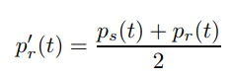
Relexicalization using cognate counts
Train a tagger on annotated HRL data
Tag-word associations
Tag sequences
→ Replace with LRL words
→ Keep unchanged
ecologista AQ 5
ecologistas AQ 4 NC 1
ecología NC 3
ecológica AQ 3
ecológicas AQ 1
ecológico AQ 8
ecológicos AQ 2
tamién RG 257 RN 257
sieglu NC 35
ecolochía NC 35 VS 12
dende RG 18 SN 18
primer AQ 14 AO 14
Asturies NP 46
asturianu AQ 79
Formula for computing counts:
DT NC 156
DT AQ 23
AQ NC 34
…
DT NC 156
DT AQ 23
AQ NC 34
…

Slide 57
Feldman et al.
Plain model transfer as baseline
Spanish tagger applied to Catalan: 36.5%
Spanish tagger applied to Portuguese: 56.9%
Czech tagger applied to Russian: 45.6%
Relexicalization using morphological analyzer:
Spanish-Catalan: 70.7%
Spanish-Portuguese: 77.2%
Czech-Russian: 78.6%
Relexicalization using cognates:
Spanish-Catalan: 75.2%
Spanish-Portuguese: 82.1%
Czech-Russian: 80.4%

Slide 58
Model transfer
Assumptions regarding the linguistic proximity between HRL and LRL?
Word order
Polysemy
Homonymy

Slide 59
Tomorrow...

Slide 60
Readings
Yves Scherrer & Achim Rabus (2017): Multi-source morphosyntactic tagging for Spoken Rusyn. Proceedings of VarDial 2017.
Plain model transfer using multiple high-resource languages
Delphine Bernhard & Anne-Laure Ligozat (2013): Hassle-free POS-Tagging for the Alsatian Dialects. In: Marcos Zampieri & Sascha Diwersy: Non-Standard Data Sources in Corpus Based-Research, Shaker, ZSM Studien.
“Minimalistic relexicalization by hand”

